Slide 1


Module 4: Safety
Inclusive digital competence training for labor market risk groups
Learning Material for Adult Learners

Slide 2


Consortium

Slide 3

Project Aims:
The inDigital project aims at:
Improving the skills of trainers, mentors, training organizations and NGOs to provide training to target groups, without digital skills and at risk in the labor market, including – the unemployed, people without digital skills, and youth out of education and employment;
Increasing curricula’ flexibility for training on basic key competencies, by introducing digital tools, self-assessment methodology, and practical and game techniques to support specific target groups.
Increasing the employability of VET learners facing global challenges related to digital transformation.
Encouraging interaction between educational organizations, trainers, mentors, and NGOs to benefit learners and increase the attractiveness of VET.

Slide 4
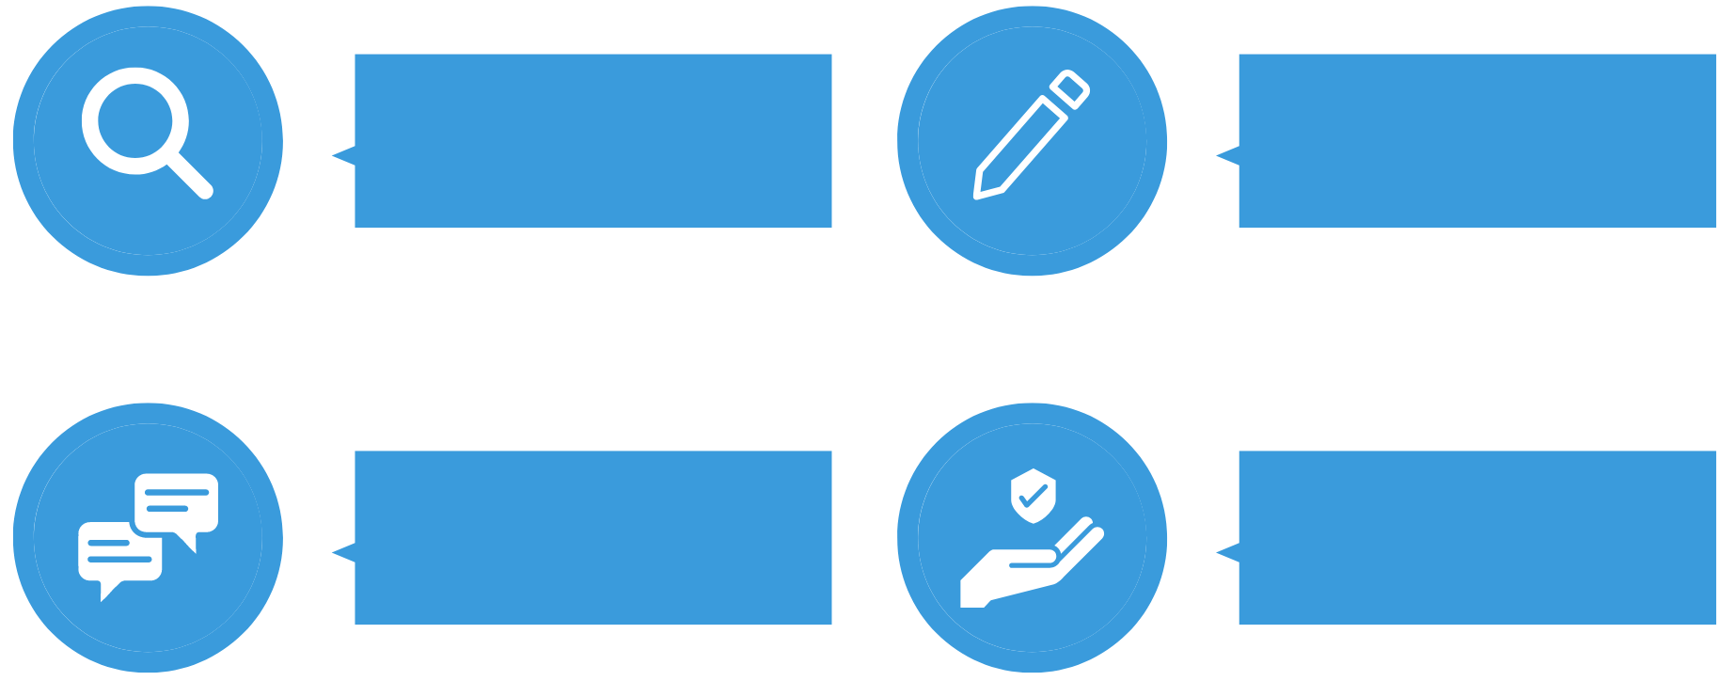
Learning Material Modules
Information &
Data Literacy
Digital Content Creation
Safety
Communication & Collaboration

Slide 5

01
Introduction & Learning Outcomes
02
Topic 1: Risks
03
Table of Contents
Topic 2: Measures
04
Topic 3: Netiquette
05
Conclusion & Bibliography

Slide 6
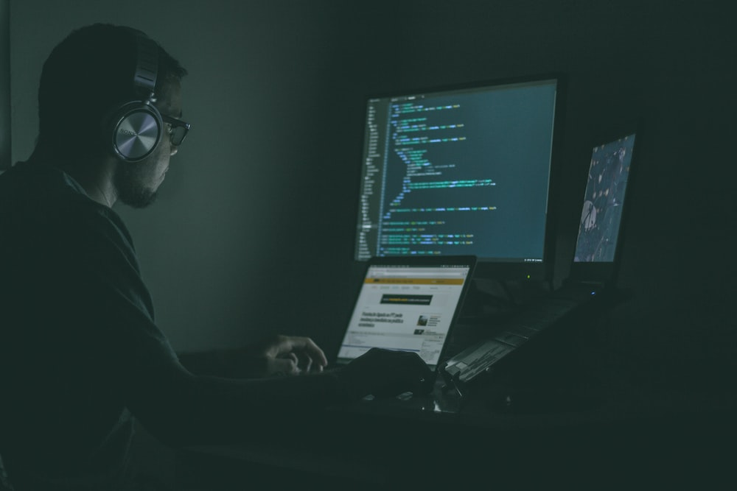
Introduction
The following module will introduce the learners the following:
Information on different aspects of safety with regard to risks and threats involved in carrying out:
- Activities online
- Measures
- Netiquette
Figure 1: Programming Source: Unsplash
Notes:
Title:
Font: Gadugi
Size: 24
Main body:
Font: Arial Narrow
Size: 20

Slide 7
Learning Outcomes
Phishing
Risks
Pharming
Social Engineering
Strong password
Antimalware software
SAFETY
Measures
Data backup
Encryption firewall
Netiquette
Online Shopping
Notes:
Title:
Font: Gadugi
Size: 24
Main body:
Font: Arial Narrow
Size: 20

Slide 8

Topic 1: Risks
Main Objectives:
Introduce to learners the different risks of online safety.
Explain the threats that may occur with data/information.
Enable the learners to identify possible types of risks:
1. Phishing
2. Pharming
3. Social Engineering
Figure 2: Hacker attack Source: Unsplash

Slide 9

Topic 1: Risks
In consonance with UNext webpage (2022) “Cyber Security is becoming a severe issue for individuals, enterprises, and governments alike. In a world where everything is on the internet, from cute kitten videos and our travel diaries to our credit card information, ensuring that our data remains safe is one of the biggest challenges of Cyber Security”. Besides, “we expect the increase in cyberattack activity to only increase. With AI technologies such as ChatGPT readily available to the public, it is possible for hackers to generate malicious code and emails at a faster, more automated pace” (Check Point Blog, 2023).
Figure 3: Browser Source: Unsplash

Slide 10
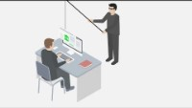
Topic 1: Risks
What is Cybercrime?
Cybercrime is the term used to describe crimes which take place digitally, this is, an act in which there is not physical interaction between the victim and the attacker.
What is Phishing?
In a phishing attack, the victim or victims are contacted by the attacker through various digital means, such as: emails, text messages or even through a phone call. They present a relatively believable scenario, where they impersonate a legitimate organization and try to persuade their victims to provide them with sensitive personal information (Phishing.org webpage, n.d.).

Slide 11

Topic 1: Risks
What is Pharming?
As stated in Proofpoint webpage (n.d.) “pharming is like phishing in that it is a threat that tricks users into divulging private information, but instead of relying on email as the attack vector, pharming uses malicious code executed on the victim's device to redirect to an attacker-controlled website”.

Slide 12
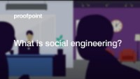
Topic 1: Risks
What is Social Engineering?
“Social engineering is a manipulation technique used by cyber criminals to trick people into giving up confidential information. Social engineering relies on the basic human instinct of trust to steal personal and corporate information that can be used to commit further cyber crimes” (Terranova Security webpage, n.d.).

Slide 13
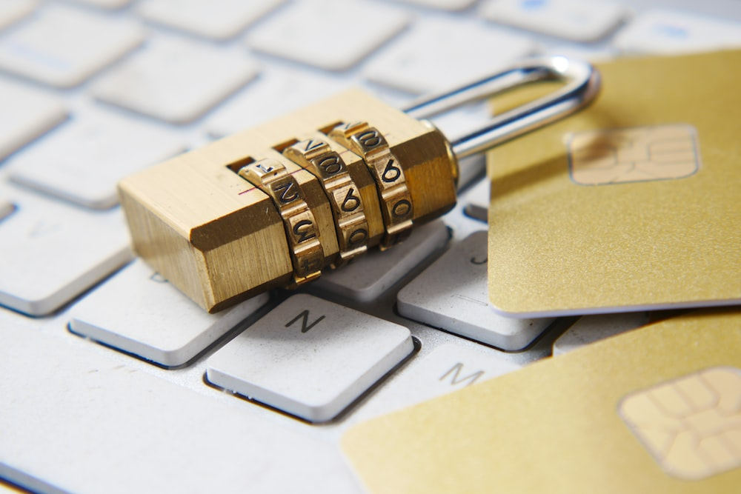
Topic 2: Measures
Main Objectives:
Teach learners the most common security measures:
1. Strong passwords
2. Antimalware software
3. Data backup
4. Encryption firewall
Explain learners how to accomplish secure online shopping.
Figure 3: Padlock Source: Unsplash

Slide 14

Topic 2: Measures
After analyzing the types of risks we face on a daily basis, it is important and necessary to know what measures are available to us and therefore, make it difficult and even impossible for those persons and/or individuals who want to steal or impersonate our online identity.
Figure 4: Stop Source: Unsplash

Slide 15

Topic 2: Measures
Strong passwords and the importance of these
The strength of the password is basically the amount of time it takes someone to crack it. As we know, the Internet offers many benefits as well as dangers to its user. Due to the myriads of services offered to us through the Internet, we need to make sure that the details we provide each time when creating an account for such services are protected (Secure Data Recovery webpage, n.d.).

Slide 16
Topic 2: Measures
How to create strong passwords: (GCFGlobal Website)
Never use personal information
Use a longer password. Your password should be at least six characters long, although for extra security it should be even longer.
Don't use the same password for each account.
Try to include numbers, symbols, and both uppercase and lowercase letters.
Avoid using words that can be found in the dictionary. For example, swimming1 would be a weak password.
Random passwords are the strongest. If you're having trouble creating one, you can use a password generator instead.

Slide 17
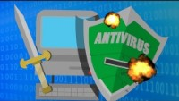
Topic 2: Measures
Antimalware software and the importance of this
Antimalware Software is the program responsible for protecting our devices from malicious software. Malicious software is any program which looks for vulnerabilities in systems and depending on their intention perform a series of damaging for the systems and its users’ action. Good common practices include:
Scan downloaded files
Scan newly connected storage devices
Run regular system scans

Slide 18
Topic 2: Measures
How to install an antimalware in the computer: (Microsoft’s Support Website)
Microsoft:
To enable or disable Microsoft Defender Antivirus:
Select Start > Settings > Update & Security > Windows Security > Virus & threat protection.
Under Virus & threat protection settings, select Manage settings.
Under Real-time protection, change the setting to On or Off.
For optimal protection, turn on the settings for Cloud-delivered protection and Automatic sample submission.

Slide 19
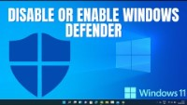
Topic 2: Measures
How to install an antimalware in the computer: (Microsoft’s Support Website)
Microsoft:

Slide 20
Topic 2: Measures
How to install an antimalware in the computer: (Apple’s Support website)
Apple:
On your Mac, choose Apple menu > System Settings, then click Privacy & Security in the sidebar. (You may need to scroll down.)
Go to Security, click the pop-up menu next to “Allow applications downloaded from,” then choose the sources from which you’ll allow software to be installed:
App Store: Allows apps only from the Mac App Store. This is the most secure setting. All the developers of apps in the Mac App Store are identified by Apple, and each app is reviewed before it’s accepted. macOS checks the app before it opens the first time to be certain it hasn’t been modified since the developer shipped it. If there’s ever a problem with an app, Apple removes it from the Mac App Store.
App Store and identified developers: Allows apps from the Mac App Store and apps from identified developers. Identified developers are registered with Apple and can optionally upload their apps to Apple for a security check. If problems occur with an app, Apple can revoke its authorization. macOS checks the app before it opens the first time to be certain it hasn’t been modified since the developer shipped it.

Slide 21

Topic 2: Measures
How to install an antimalware in the computer: (Apple’s Support website)
Apple:

Slide 22
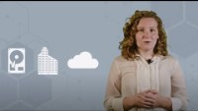
Topic 2: Measures
Data Backup and the importance of this
Backing up your data is one of the most important processes that people using various digital devices should get used to. Having your data information in one place is convenient and secure as well as a bit dangerous. Let us say that the office where both your computer and backup storage device are stored is destroyed due to fire. Then there is now way for data to be retrieved.

Slide 23
Topic 2: Measures
How to do a data backup – 6 strategies: (Kyle Chin, 2022)
Use an External Hard Drive
Use a USB Flash Drive
Use Optical Media
Use Cloud Storage
Use an Online Backup Service
Invest in a Network Attached Storage (NAS) Device

Slide 24

Topic 2: Measures
Encryption firewall and the importance of this
The firewall is a program responsible for “Filtering Data” going in and out of our computer device and the Internet. Data arrives and leaves in packets, however before those packets are send to their destination or received they must first pass a check. The check is performed by the Firewall, which is a program responsible for regulating this data traffic and if a data packet is not supposed to be received or sent is “burned”.

Slide 25

Topic 2: Measures
How can I make a proper and secure Online shopping?
According to Tidio webpage (2023) “over 2.14 billion shoppers now buy items online, which is a significant increase from just a few years ago. With the current world population of 7.9 billion, it means that 27% of all people that are alive are digital buyers”.
What if I am part of this number of people, what should I take into account? Take a look at the video on the left!

Slide 26
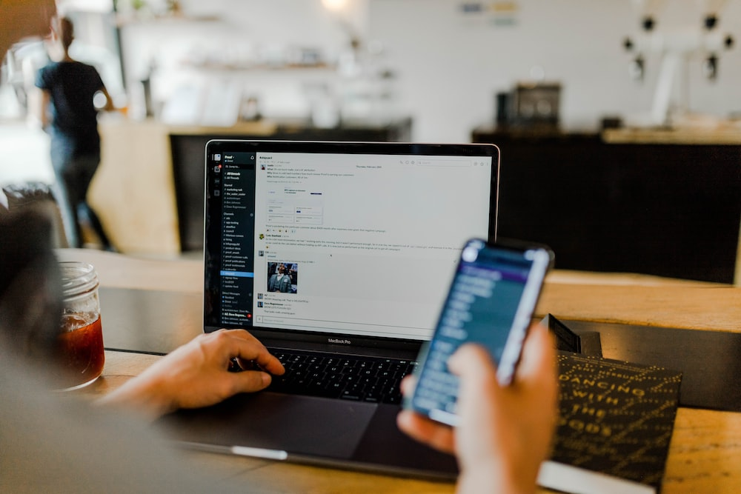
Topic 3: Netiquette
Main Objectives:
Make clear learners what netiquette is.
Ensure that learners understand the importance of netiquette in their online behaviour.
Learn the rules of etiquette that need to be applied when communicating over the Internet or social networks.
Figure 5: Online Communication Source: Unsplash

Slide 27

Topic 3: Netiquette
However, it is not all external risks and we must also bear in mind that we ourselves can expose ourselves through our use of different networks and how we do it. In case you still don't understand what I mean, here are the following slides.
Figure 6: Confusion Source: Unsplash

Slide 28

Topic 3: Netiquette
Topic 3: [name]
What is Netiquette?
"Netiquette" refers to Internet etiquette, and it’s essentially the use of good manners in online communication such as social media, e-mails and chats. It is important to employ good netiquette in our online communications, since most of them are essentially us reading text that someone else has typed.

Slide 29
Topic 3: Netiquette
Topic 3: [name]
Why is using Netiquette important? (McGee, 2019)
Potential consequences of not using Netiquette
People may become upset if they misunderstand
Risk of appearing insensitive towards others
Communication breakdown: the meaning is not passed on across
Risk destroying friendship and other relationships
Benefits of using Netiquette
Helps create and sustain online relationships
Maintains online interaction constructively and friendly
We show that we respect others online
Helps getting the correct meaning across

Slide 30

Topic 3: Netiquette
Topic 3: [name]
What are the rules of Netiquette in social media? (Molinaro, 2022)
Represent yourself well
Respect other people’s privacy
If you wouldn’t say it directly, don’t say it online
Follow the rules
Fact check
Respect people’s time and boundaries
Respond as promptly as you can
Be forgiving
…

Slide 31
Conclusion
To conclude, after the development of this module it is evident that there are a number of risks that we have to be aware of when using online communication and what it entails. However, if we wish, there are a variety of measures, such as the use of strong passwords, which allow us to easily take care of what is ours and not put ourselves into danger.
It should also be noted that although it is perhaps the most frightening thing for some people to have their social network account stolen, we should be cautious and aware that having an account on a social network requires being careful and that incorrect use of them can also end up affecting us.
Notes:
Title:
Font: Gadugi
Size: 24
Main body:
Font: Arial Narrow
Size: 20

Slide 32
Bibliography
Byuicurdev. (2012, June 12). Discussion Board Netiquette [Video]. YouTube. https://www.youtube.com/watch?v=DwdqQjCfWSc
DocstocTV. (2011, October 25). What is Netiquette & Why is it Important? [Video]. YouTube. https://www.youtube.com/watch?v=gvkbDc1LiVI
Eye on Tech. (2020, July 22). What is Data Backup and Why is it Important? [Video]. YouTube. https://www.youtube.com/watch?v=FIL6L7f32Bs
Fokina, M. (2023, January 30). Online Shopping Statistics: Ecommerce Trends for 2023. Tidio. https://www.tidio.com/blog/online-shopping-statistics/
G. (2023, January 5). Check Point Research Reports a 38% Increase in 2022 Global Cyberattacks. Check Point Software. https://blog.checkpoint.com/2023/01/05/38-increase-in-2022-global-cyberattacks/
How to Use "Sell" and "Sale" Correctly. (2022, May 14). The Classroom | Empowering Students in Their College Journey. https://www.theclassroom.com/use-sell-sale-correctly-4501035.html
Identity Management Institute. (2017, May 20). Stay Safe When Shopping Online [Video]. YouTube. https://www.youtube.com/watch?v=LC_qM1P6nG4
IDG TECHtalk. (2019, August 28). What is phishing? Learn how this attack works [Video]. YouTube. https://www.youtube.com/watch?v=Y7zNlEMDmI4
K. (n.d.). Phishing | What Is Phishing? https://www.phishing.org/what-is-phishing
LastWeekTonight. (2015, April 9). Edward Snowden on Passwords: Last Week Tonight with John Oliver (HBO) [Video]. YouTube. https://www.youtube.com/watch?v=yzGzB-yYKcc
Notes:
Title:
Font: Gadugi
Size: 24
Main body:
Font: Arial Narrow
Size: 20

Slide 33
Bibliography
Molinaro, D. (2023, February 23). Netiquette: Rules & Guidelines. Netiquette: Rules & Guidelines. https://www.avast.com/c-netiquette
PowerCert Animated Videos. (2019, June 17). What is a Firewall? [Video]. YouTube. https://www.youtube.com/watch?v=kDEX1HXybrU
Proofpoint. (2019, August 14). What is Social Engineering? | Proofpoint Cybersecurity Education Series [Video]. YouTube. https://www.youtube.com/watch?v=9U-JgdUkaTQ
Secure Data Recovery Services. (2021, August 31). RAID, SSD & Hard Drive Data Recovery Services | Secure Data Recovery Services. https://www.securedatarecovery.com/resources/the-importance-of-strong-secure-passwords
Sunny Classroom. (2021, August 19). Pharming by DNS poisoning & Domain Hijacking [Video]. YouTube. https://www.youtube.com/watch?v=PAtUSoIRJhA
UNext Editorial Team. (2023, January 18). Top 10 Challenges of Cyber Security Faced in 2022. UNext. https://u-next.com/blogs/cyber-security/challenges-of-cyber-security/
WASTETIME. (2017, June 14). How Does Antivirus and Antimalware Software Work? [Video]. YouTube. https://www.youtube.com/watch?v=bTU1jbVXlmM
What is Pharming? - Definition, Examples & More | Proofpoint US. (2023, February 8). Proofpoint. https://www.proofpoint.com/us/threat-reference/pharming#:~:text=Pharming%20is%20like%20phishing%20in,to%20an%20attacker%2Dcontrolled%20website
What is Social Engineering | Terranova Security. (2023, January 12). https://terranovasecurity.com/what-is-social-engineering/
Notes:
Title:
Font: Gadugi
Size: 24
Main body:
Font: Arial Narrow
Size: 20

Slide 34
Inclusive digital competence training for labor market risk groups

